Slide 1



Project 1.1
View in Power BI
Last data refresh:
26-12-2024 11:02:55 UTC
Downloaded at:
26-12-2024 11:03:52 UTC

Slide 2
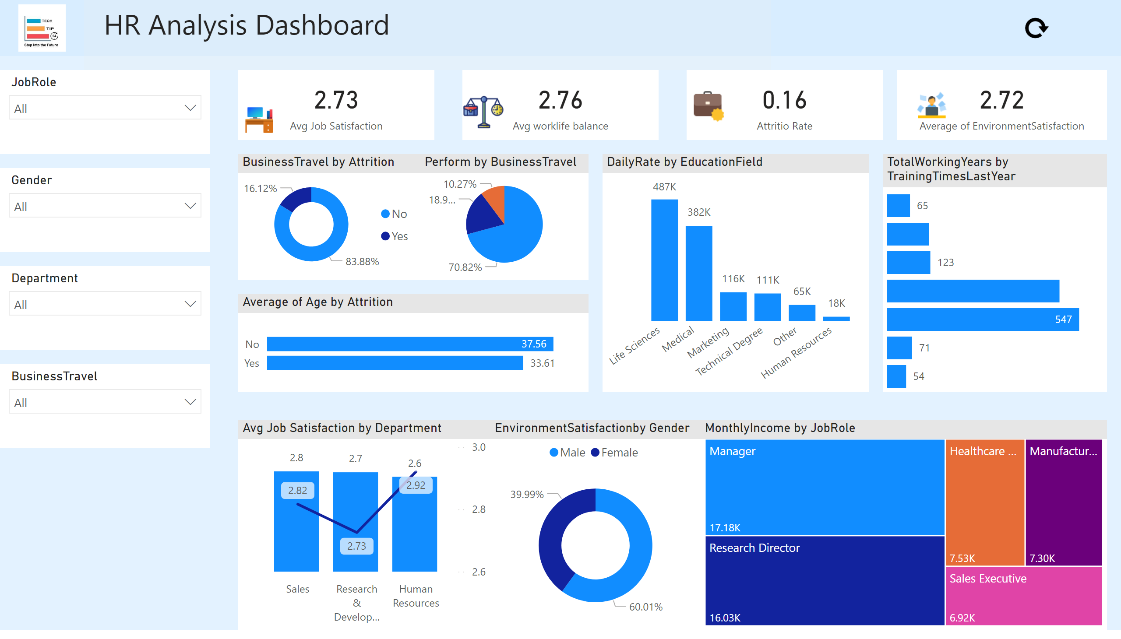
HR Analytics Dashboard
Notes:
shape
No alt text provided
slicer
No alt text provided
slicer
No alt text provided
card
No alt text provided
textbox
No alt text provided
image
No alt text provided
card
No alt text provided
image
No alt text provided
slicer
No alt text provided
slicer
No alt text provided
card
No alt text provided
card
No alt text provided
BusinessTravel by Attrition
No alt text provided
Perform by BusinessTravel
No alt text provided
treemap
No alt text provided
DailyRate by EducationField
No alt text provided
EnvironmentSatisfactionby Gender
No alt text provided
barChart
No alt text provided
Avg Job Satisfaction by Department
No alt text provided
TotalWorkingYears by TrainingTimesLastYear
No alt text provided
image
No alt text provided
image
No alt text provided
image
No alt text provided
image
No alt text provided

